Slide 1

COMPUTER SCIENCE PROJECT
Hotel Management
Group Members
Gilchrist, Firdaus , Elvin

Slide 2
CERTIFICATE

Slide 3
ACKNOWLEDMENT
It’s my humble pleasure to acknowledge my deep sense of gratitude to my Computer Science teacher, Mrs. Smitha Somarajan for her constant help and guidance at each stage. I also express my special thanks to our principal Mr. Srivalsan Murugan for his immense encouragement that has made this project successful. I take this opportunity to express my gratitude and respect to all those who helped in the completion of this project.

Slide 4
INDEX
Sl.No | CONTENTS
1 | Introduction
2 | Objective and Scope of the Project
3 | Theoretical Background of the Project
4 | System Implementation
5 | System Design and Development
6 | Source Code
7 | Results and Discussion
8 | Conclusion and Future scope
9 | Bibliography

Slide 5
Introduction
Our project is based on various hotel chains around the world such as Hilton , Radisson Blu etc. We have given the customers the option for their personal preferences for them to have a pleasant stay with us at The Paradise Hotel. Customers can book with us using a variety of attractive packages. The project has incorporated various modules which thereby allows visitors to choose the package or their choice , the room they wish, to get the room number , to check status of customer etc. We have also taken back feedback from friends and family for best service.

Slide 6
Objective and Scope of the Project
The Hotel Management program developed by my team gives an insight on how the management system of a hotel works and makes the organization function efficiently.
The following objectives were kept in mind while designing this program:-
1. A general idea on the working of a hotel management
system.
2. Cutting short the processing time.
3. To make ourselves understand the working of Python
together with MySQL using database connectivity.
4. To familiarize ourselves with the concepts of Python and MySQL

Slide 7

Theoretical Background of the Project
Python
Python is an interpreted, object-oriented, high-level programming language with dynamic semantics.
It has built-in data structures, combined with dynamic typing and dynamic binding, making it very attractive for rapid application development, scripting, or as a glue language to connect existing components together.
Python was originally created in 1991 by Guido van Rossum.

Slide 8

Spyder
Spyder is a free and open-source scientific environment written in Python, for Python, and designed by and for scientists, engineers and data analysts. It features a unique combination of the advanced editing, analysis, debugging, and profiling functionality of a comprehensive development tool with the data exploration, interactive execution, deep inspection, and beautiful visualization capabilities of a scientific package.

Slide 9

MySQL
MySQL is a relational database management system (RDBMS) developed by Oracle that is based on structured query language (SQL).
A database is a structured collection of data. It may be anything from a simple shopping list to a picture gallery or a place to hold the vast amounts of information in a corporate network. A relational database is a digital store collecting data and organizing it according to the relational model. In this model, tables consist of rows and columns, and relationships between data elements all follow a strict logical structure. An RDBMS is simply the set of software tools used to implement, manage, and query such a database.

Slide 10
System Implementation
Hardware Specifications
Brand | Acer
Model | Acer Predator Helios 300
Processor | Intel Core i7-10750H
Memory | 8GB
Graphics Card | RTX 3070
Operating System | Windows 10
Software Specifications
Windows 10
MySQL
Python
Spyder IDE

Slide 11
System Design and Development
mysql.connector - The "mysql.connector" module helps connect Python with MySQL. In this program we have used:
fetchall(): cursor.fetchall() fetches all the rows of a query result. It returns all the rows as a list of tuples.
db.cursor( ): Allows Python code to execute PostgreSQL command in a database session. Cursors are created by the connection.cursor( ) method.
cursor.execute( ): This method executes the given database operation (query or command). The parameters found in the tuple or dictionary params are bound to the variables in the operation.
db.commit( ) : db.commit() method sends a COMMIT statement to the MySQL server, committing the current transaction
datetime - The "datetime" module provides a number of function to deal with dates, times and time intervals. In this program we've used the "datetime" funtion from the "datetime" module.

Slide 12
Tabulate – Tabulate is an open-source python package/module which is used to print tabular data in nicely formatted tables .It is easy to use and contains a variety of formatting functions
Random- The “random” module implements random number generators for various distributions. In this program we've used the randint function
Pandas- pandas is a software library written for the Python programming language for data manipulation and analysis. The name is derived from the term "panel data", an econometrics term for data sets that include observations over multiple time periods for the same individuals.
Matplotlib- Matplotlib is a plotting library for the Python programming language and its numerical mathematics extension NumPy. It provides an object-oriented API for embedding plots into applications.

Slide 13

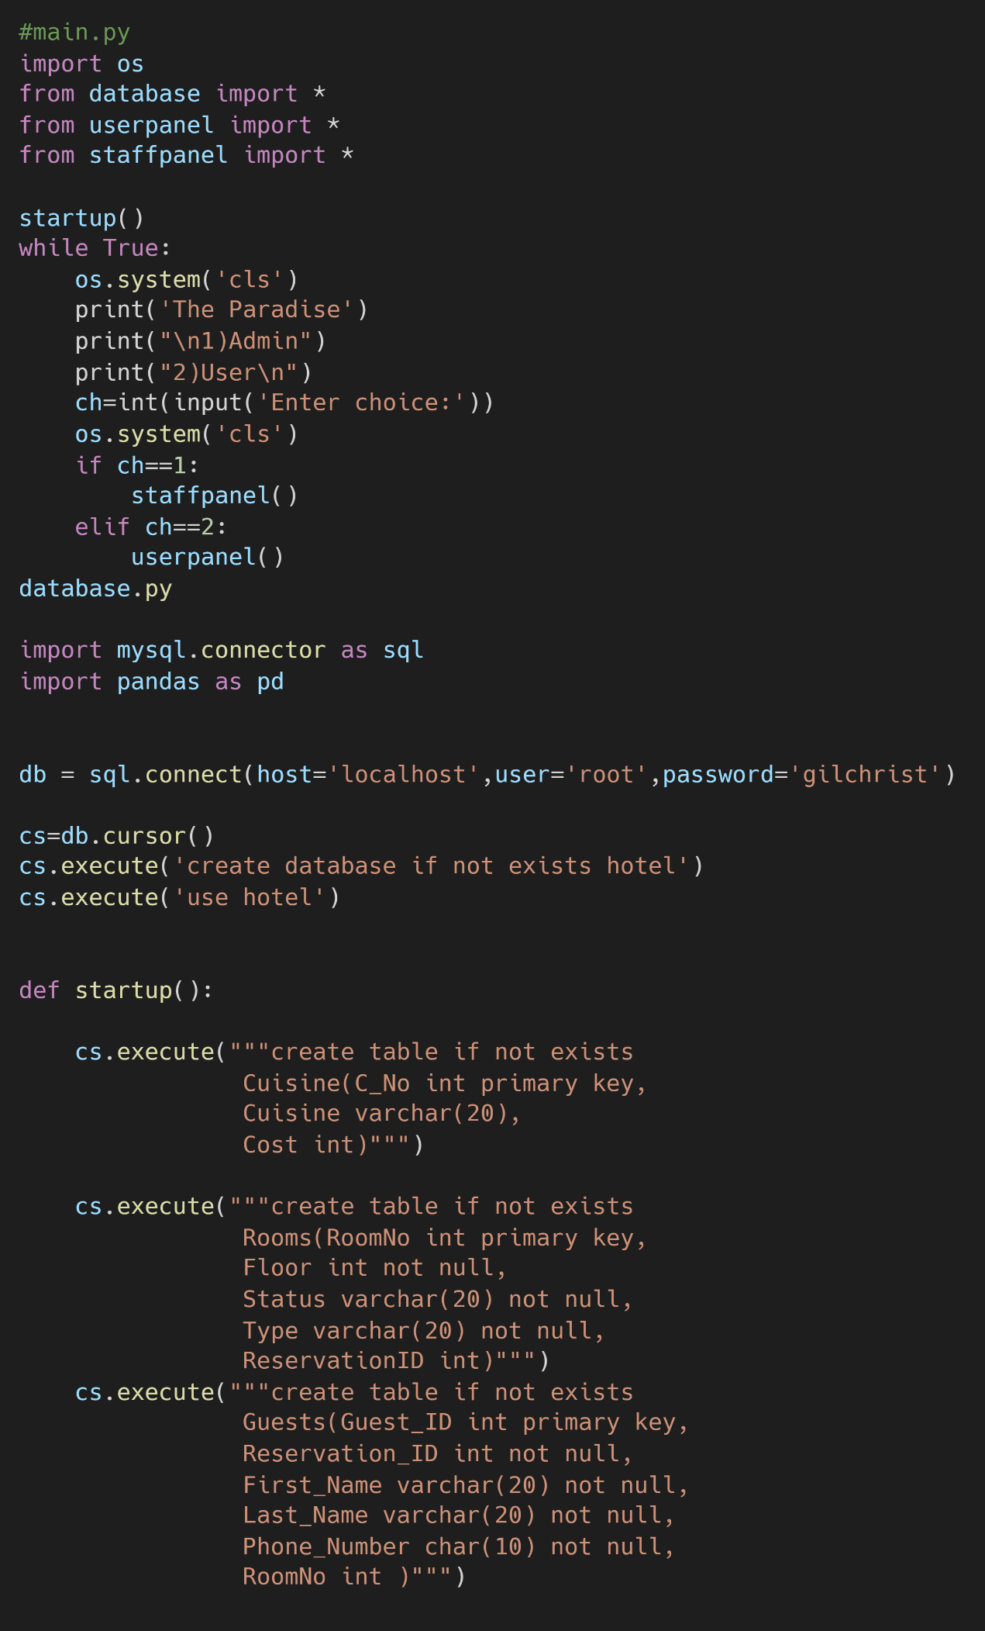
Source Code
main.py
import os
from database import *
from userpanel import *
from staffpanel import *
startup()
while True:
os.system('cls')
print('The Paradise')
print("\n1)Admin")
print("2)User\n")
ch=int(input('Enter choice:'))
os.system('cls')
if ch==1:
staffpanel()
elif ch==2:
userpanel()
database.py
import mysql.connector as sql
import pandas as pd
db = sql.connect(host='localhost',user='root',password='gilchrist')
cs=db.cursor()
cs.execute('create database if not exists hotel')
cs.execute('use hotel')
def startup():
cs.execute("""create table if not exists
Cuisine(C_No int primary key,
Cuisine varchar(20),
Cost int)""")
cs.execute("""create table if not exists
Rooms(RoomNo int primary key,
Floor int not null,
Status varchar(20) not null,
Type varchar(20) not null,
ReservationID int)""")
cs.execute("""create table if not exists
Guests(Guest_ID int primary key,
Reservation_ID int not null,
First_Name varchar(20) not null,
Last_Name varchar(20) not null,
Phone_Number char(10) not null,
RoomNo int )""")

Slide 14
cs.execute("""create table if not exists
Reservations(Reservation_ID int primary key,
Guest_ID int not null,
PkCode int not null,
Phone_Number char(10) not null,
CheckIn date not null,
CheckOut date not null,
Nights int,
RoomNo int ,
Expenses int not null,
constraint check_PkCode check (PkCode between 1 and 12)
)
""")
cs.execute("""create table if not exists
Employees(Empcode int primary key,
Empname varchar(20) not null,
Designation varchar(20) not null,
Salary int not null,
DateofJoin date not null)
""")
cs.execute("""create table if not exists
Packages(Pk_Code int primary key,
Max int not null,
Room_Type varchar(20) not null,
Package_Type varchar(100) not null,
Cost_Per_Night int not null,
Tourism_Fee int not null)
""")
cs.execute("""create table if not exists
History(First_Name varchar(20) not null,
Last_Name varchar(20) not null,
Phone_Number char(10) primary key,
Pk_code int not null,
Expenses int not null,
CheckIn date not null,
Checkout date not null,
FeedBack int not null,
Comments varchar(200),
constraint check_FeedBack check (Feedback between 1 and 10)
)
""")
print('Startup Done')
cs.execute('select count(*) from rooms')
count=cs.fetchone()[0]
if count!=24:
insert_values()

Slide 15
def insert_values():
Packages =pd.read_excel('Hotel.xlsx' , 'Packages' ).to_dict(orient='list')
Pkcode=Packages['Pkcode']
People=Packages['People']
Type=Packages['Type']
Details=Packages['Details']
Rate=Packages['Rate']
Tourism=Packages['Tourism']
for i in range(0,len(Pkcode)):
cs.execute(f'insert into Packages values({Pkcode[i]},{People[i]},"{Type[i]}","{Details[i]}",{Rate[i]},{Tourism[i]})')
Rooms =pd.read_excel('Hotel.xlsx' , 'Rooms' ).to_dict(orient='list')
RoomNo=Rooms['RoomNo']
Floor=Rooms['Floor']
Status=Rooms['Status']
Type=Rooms['Type']
rid=Rooms['Reservation id']
for i in range(0,len(RoomNo)):
cs.execute(f'insert into Rooms values({RoomNo[i]},{Floor[i]},"{Status[i]}","{Type[i]}",{rid[i]})')
History =pd.read_excel('Hotel.xlsx' , 'Feedback' ).to_dict(orient='list')
fname=History['FirstName']
lname=History['LastName']
phone=History['PhoneNumber']
Pk_Code=History['Pk_Code']
Exp=History['Expenses']
checkin=History['CheckIn']
checkout=History['Checkout']
feedback=History['Feedback']
comments=History['Comments']
for i in range(0,len(fname)):
cs.execute(f'insert into history values("{fname[i]}","{lname[i]}","0{phone[i]}",{Pk_Code[i]},{Exp[i]},{checkin[i]},{checkout[i]},{feedback[i]},"{comments[i]}")')
cs.execute('insert into Guests values(1004648,12944,"Jordan","Cross","0507313342",NULL)')
cs.execute('insert into Guests values(1017095,10435,"Eric","Soders","0524345211",NULL)')
cs.execute('insert into Reservations values(10435,1017095,7 ,"0524345211","2022-09-02" ,"2022-09-21" ,19,NULL,18050)')
cs.execute('insert into Reservations values(10862,1083125,3 ,"0567681598","2022-07-23" ,"2022-07-31" ,8,302,9800)')
cs.execute('insert into Reservations values(12944,1004648,11 ,"0507313342","2022-08-20" ,"2022-08-30" ,10,NULL,16200)')
cs.execute('insert into Cuisine values(1,"Indian",150)')
cs.execute('insert into Cuisine values(2,"Continental",300)')
cs.execute('insert into Cuisine values(3,"Chinese",150)')
cs.execute('insert into Cuisine values(4,"Mediterranean",300)')
cs.execute('insert into Cuisine values(5,"Japanese",200)')
cs.execute('insert into Cuisine values(6,"American",250)')
cs.execute('insert into Cuisine values(7,"Thai",250)')
cs.execute('insert into Cuisine values(8,"Turkish",300)')
db.commit()

Slide 16
userpanel.py
import os
from database import *
from tabulate import tabulate
from datetime import datetime
from random import randint
def createReservation():
cs.execute('select * from packages')
r=cs.fetchall()
print('\n\t\t\t\t\tPackages \n\n')
print(tabulate(r , headers=['PkCode' , "People" , 'Room Type' , 'Package Details', 'Cost Per Night' , 'Tourism'],tablefmt='fancy_grid'))
print('\n\n')
pkchoice=int(input("Select the package:"))
os.system('cls')
cs.execute(f"select* from packages where pk_code={pkchoice}")
r=cs.fetchall()
package=r[0]
pkcode,_,room_type,pk_type,rate,tourism=package
print(f'Package {pkchoice} selected')
checkIn=input('Enter Check in Date(yyyy/mm/dd):')
checkOut=input('Enter Check Out Date(yyyy/mm/dd):')
checkin_d = datetime.strptime(checkIn, '%Y/%m/%d').date()
checkout_d = datetime.strptime(checkOut, '%Y/%m/%d').date()
days = (checkout_d - checkin_d).days
if days<0:
print('Invalid Dates Provided')
return
pk_room ={
"Standard":"1,2,3",
"Deluxe":"4,5,6",
"Single Suite":"7,8,9",
"Family Suite":"10,11,12"
}
cs.execute(f""" select count(*) from reservations
where "{CheckIn}" between CheckIn and Checkout and PkCode in ({pk_room[RoomType]})""")
count,=cs.fetchone()
if count>=6:
print('\n Our rooms are completely booked , Sorry \n')
return
fname=input('Enter first name:')
lname=input('Enter last name:')
ph=input("Enter phone number:")
cost=rate*days
torsm=input("Do you want tourism(y/n):")
if torsm=='y':
cost+=tourism

Slide 17
if 'Breakfast' in pk_type or 'Board' in pk_type:
cs.execute('select * from cuisine')
cuisines=cs.fetchall()
print(tabulate(cuisines,headers=['C.No','Cuisine','Additional Cost'],tablefmt='fancy_grid'))
cuisine=int(input('Enter C.No:'))
cs.execute(f'select * from cuisine where c_no={cuisine}')
_,cuisineName,cuisinecost=cs.fetchone()
cost+=cuisinecost
guestid=1000000+randint(0,99999)
rid=10000+randint(0,9999)
cs.execute(f"insert into reservations values({rid},{guestid},{pkchoice},'{ph}','{checkin_d}','{checkout_d}',{days},Null,{cost})")
cs.execute(f"insert into Guests values({guestid},{rid},'{fname}','{lname}','{ph}',Null)")
db.commit()
print('Reservation Made')
print('\n=======================================')
print('\t\t Receipt\n\n')
print(f' Name:{fname} {lname}')
print(f' Phone Number: {ph}')
print(f' Reservation ID: {rid}')
print(f' CheckInDate: {checkin_d}')
print(f' Checkout Date: {checkout_d}')
print(f' Days: {days}')
print(f' Package Type : {pk_type}')
print(f' Room Type : {room_type}')
print(f' Expenses: {cost} AED')
print('\n======================================‘)
def checkIn():
phonenum=input('Enter Phone Number:')
cs.execute(f'select * from reservations where Phone_Number="{phonenum}"')
result=cs.fetchall()
reservation=result[0]
rid,gid,Pkcode,_,CheckIn,Checkout,_,RoomNo,Expenses = reservation
if RoomNo!=None:
print('You have already checked in')
return
cs.execute(f'select * from packages where Pk_code={Pkcode}')
package=cs.fetchall()[0]
RoomType=package[2]
cs.execute(f'select RoomNo,Floor,Status,Type from Rooms where Type="{RoomType}" and Status="Vacant"')
rooms=cs.fetchall()
print('\n')
print('\t Available Rooms \t')
print('\n')
print(tabulate(rooms,headers=['RoomNo','Floor','Status','Type'],tablefmt='fancy_grid'))
print('\n’)
roomchoice=int(input('Enter room number:'))
cs.execute(f'select * from Rooms where RoomNo={roomchoice} and Status="Vacant" and Type="{RoomType}"')
selected=cs.fetchall()
if len(selected)==0:
print('No Room Available')
return;

Slide 18
cs.execute(f'select * from Guests where Guest_ID={gid}')
guest=cs.fetchall()[0]
_,_,fname,lname,_,_=guest
mop=input('Enter mode of payment(Cash/Card):').upper()
print('\n=======================================')
print('\t\t Bill\n\n')
print(f' Name:{fname} {lname}')
print(f' Phone Number: {phonenum}')
print(f' Reservation ID: {rid}')
print(f' CheckInDate: {CheckIn}')
print(f' Checkout Date: {Checkout}')
print(f' Payment Mode: {mop}')
print(f' Expenses: {Expenses} AED')
print('\n\tPlease Pay at the counter')
print('\n======================================')
cs.execute(f'update Rooms set Status="Occupied",ReservationID={rid} where RoomNo={roomchoice}')
cs.execute(f'update guests set RoomNo={roomchoice} where Guest_ID={gid}')
cs.execute(f'update reservations set RoomNo={roomchoice} where Reservation_ID={rid}')
db.commit()
print()
print('Successfully checked in you may collect your room key card from the kiosk')
print('Enjoy your stay\n’)
def checkOut():
phonenum=input('Enter Phone Number:')
cs.execute(f'select * from reservations where Phone_Number="{phonenum}"')
result=cs.fetchall()
if(len(result)==0):
print('Invalid Phone Number')
return
reservation=result[0]
rid,gid,Pkcode,_,CheckIn,Checkout,_,RoomNo,Expenses = reservation
if RoomNo=='Not CheckedIn':
print('You cannot CheckOut')
return
cs.execute(f'select First_Name,Last_Name from Guests where Phone_Number="{phonenum}"')
fname,lname=cs.fetchall()[0]
score=int(input(f'On a scale of 1-10 how would you rate your stay {fname}:'))
if score<1 or score>10:
print('Invalid Score')
return
comments=input('Anything You want to say about your stay?\n')
cs.execute(f'update Rooms set Status="Cleaning",ReservationID=NULL where RoomNo={RoomNo}')
cs.execute(f'delete from Guests where Guest_ID={gid}')
cs.execute(f'delete from reservations where Reservation_ID={rid}')
cs.execute(f'insert into history values("{fname}","{lname}","{phonenum}",{Pkcode},{Expenses},"{CheckIn}","{Checkout}",{score},"{comments}")')
db.commit()
print()
print('Checkout Successful')

Slide 19
def userpanel():
while True:
print('')
print('Welcome to The Paradise\n')
print("""
1)Make a Reservation
2)CheckIn
3)Checkout
4)Back""")
ch=int(input('Enter choice:'))
os.system('cls')
if ch==1:
createReservation()
elif ch==2:
checkIn()
elif ch==3:
checkOut()
elif ch==4:
break
staffpanel.py
from database import *
import os
from tabulate import tabulate
from datetime import datetime
import matplotlib.pyplot as plt
import pandas as pd
def manageReservations():
while True:
print('\nReservation Management\n')
print('1)View all Reservations')
print('2)Delete a Reservation')
print('3)Search for Reservation Details')
print('4)Back\n')
ch=int(input('Enter choice:'))
print()
os.system('cls')
headers=['Reservation ID','Guest ID','PkCode','Phone Number','CheckIn','CheckOut','Nights','RoomNo','Expenses']
if ch==1:
cs.execute("select Reservation_ID,Guest_ID,PkCode,Phone_Number,CheckIn,Checkout,Nights,Case When RoomNo is null then 'Not CheckedIn' else RoomNo end as 'RoomNo' ,Expenses from reservations")
result=cs.fetchall()
print(tabulate(result ,
headers=headers,tablefmt='fancy_grid'))
elif ch==2:
rid=int(input('Enter ReservationID:'))
cs.execute(f'delete from reservations where Reservation_ID={rid}')
db.commit()
print('\n Reservation Deleted')
elif ch==3:
rid=int(input('Enter ReservationID:'))
cs.execute(f'select * from reservations where Reservation_ID={rid}')
res=cs.fetchall()
print(tabulate(res,headers=headers,tablefmt='fancy_grid'))
elif ch==4:
break

Slide 20
def manageGuests():
while True:
print('\nGuest Management\n')
print('1)View All Guests')
print('2)View all Guests In the Hotel')
print('3)Search for Guest')
print('4)Back')
ch=int(input('Enter choice:'))
print()
os.system('cls')
headers=['GuestID','ReservationID','First Name','Last Name','Phone Number','RoomNo']
if ch==1:
cs.execute("select Guest_ID,Reservation_ID,First_Name,Last_Name,Phone_Number,Case When RoomNo is null then 'Not CheckedIn' else RoomNo end as 'RoomNo' from Guests")
result=cs.fetchall()
print(tabulate(result,
headers=headers,tablefmt='fancy_grid'))
elif ch==2:
cs.execute('select * from Guests where RoomNo is not null')
result=cs.fetchall()
print(tabulate(result,
headers=headers,tablefmt='fancy_grid'))
elif ch==3:
name=input('Enter first name or last name:')
cs.execute(f"""select Guest_ID,Reservation_ID,First_Name,Last_Name,Phone_Number,
Case When RoomNo is null then 'Not CheckedIn' else RoomNo end as 'RoomNo'
from guests where First_name like '%{name}%' or Last_name like '%{name}%'""")
res=cs.fetchall()
print(tabulate(res,headers=headers,tablefmt='fancy_grid'))
elif ch==4:
break
def manageRooms():
while True:
print('\nRoom Management\n')
print('1)View all Rooms')
print('2)View all Vacant Rooms')
print('3)View all Occupied Rooms')
print('4)View all Rooms with Cleaning Status')
print('5)Change Room Status')
print('6)Back')
ch=int(input('Enter choice:'))
print()
os.system('cls’)
if ch==1:
cs.execute("select RoomNo,Floor,Status,Type,Case When ReservationID is null then 'Not Reserved' else ReservationID End as ReservationID from Rooms")
result=cs.fetchall()
print(tabulate(result,
headers=['RoomNo','Floor','Status','Type','ReservationID'],tablefmt='fancy_grid'))
elif ch==2:
cs.execute("select RoomNo,Floor,Status,Type from Rooms where Status='Vacant'")
result=cs.fetchall()
print(tabulate(result,
headers=['RoomNo','Floor','Status','Type'],tablefmt='fancy_grid'))

Slide 21
elif ch==3:
cs.execute("select * from Rooms where Status='Occupied'")
result=cs.fetchall()
print(tabulate(result,
headers=['RoomNo','Floor','Type','ReservationID'],tablefmt='fancy_grid'))
elif ch==4:
cs.execute("select RoomNo,Floor,Status,Type from Rooms where Status='Cleaning'")
result=cs.fetchall()
print(tabulate(result,
headers=['RoomNo','Floor','Status','Type'],tablefmt='fancy_grid'))
elif ch==5:
room=int(input('Enter Room Number:'))
status=input('Enter status(Cleaning/Vacant):')
cs.execute(f'update rooms set status="{status}" where RoomNo={room}')
db.commit()
cs.execute(f'select RoomNo,Floor,Status,Type from rooms where roomno={room}')
result=cs.fetchall()
print(tabulate(result,tablefmt='fancy_grid',headers=['RoomNo','Floor','Status','Type']))
elif ch==6:
break
def dataAnalysis():
while True:
print('\nData Analysis\n')
print('1)Plot Bar Graph of Feedbacks (Pkcodes/Feedback)')
print('2)Plot Bar Graph of Visits (Month/Visits)')
print('3)Create a xlsx file of Visitor History')
print('4)Back')
ch=int(input('Enter choice:'))
os.system('cls')
if ch==1:
cs.execute('select Pk_code,avg(feedback) from history group by Pk_code order by Pk_code')
result=cs.fetchall()
pkcodes=[str(row[0]) for row in result]
scores=[row[1] for row in result]
plt.bar(pkcodes,scores)
plt.title('Average Feedback Score')
plt.xlabel('Package Code')
plt.ylabel('Score')
plt.show()
elif ch==2:
cs.execute('select month(CheckIn),Count(Checkin) from history group by month(CheckIn) order by month(CheckIn);')
result=cs.fetchall() months=['Jan','Feb','Mar','Apr','May','Jun','Jul','Aug','Sept','Oct','Nov','Dec']
visits=[0,0,0,0,0,0,0,0,0,0,0,0,]
for row in result:
month=row[0]
count=row[1]
visits[month-1]=count
plt.bar(months,visits)
plt.title('Visits')
plt.xlabel('Month')
plt.ylabel('Visits')
plt.show()

Slide 22
elif ch==3:
cs.execute('select * from history')
result=cs.fetchall()
data={
"First Name" :[row[0] for row in result],
"Last Name" : [row[1] for row in result],
"Phone Number" : [row[2] for row in result],
"Pk_Code":[row[3] for row in result],
"Expenses" :[row[4] for row in result],
"CheckIn":[row[5] for row in result],
"Checkout":[row[6] for row in result],
"Feedback":[row[7] for row in result],
"Comments" :[row[8] for row in result]
}
dt=pd.DataFrame(data)
dt.to_excel('Visitors.xlsx',index=False)
os.system('Visitors.xlsx')
elif ch==4:
break
def staffpanel():
while True:
os.system('cls')
print('\n1)Manage Reservations')
print('2)Manage Guests')
print('3)Manage Rooms')
print('4)Data Analysis')
print('5)Back\n')
ch=int(input('Enter choice:'))
if ch==1:
manageReservations()
elif ch==2:
manageGuests()
elif ch==3:
manageRooms()
elif ch==4:
dataAnalysis()
elif ch==5:
break

Slide 23
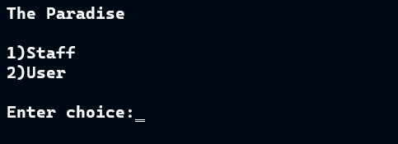
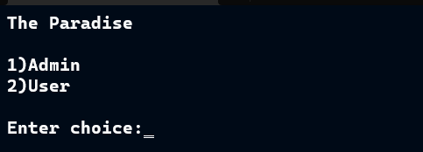
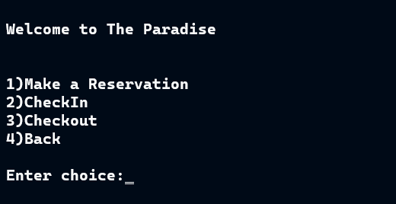
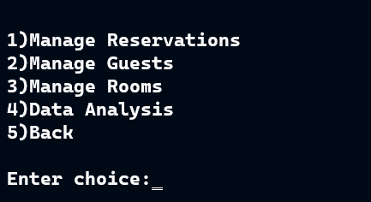
Results and Discussion
Menu
2) User Section
3) Admin Section

Slide 24
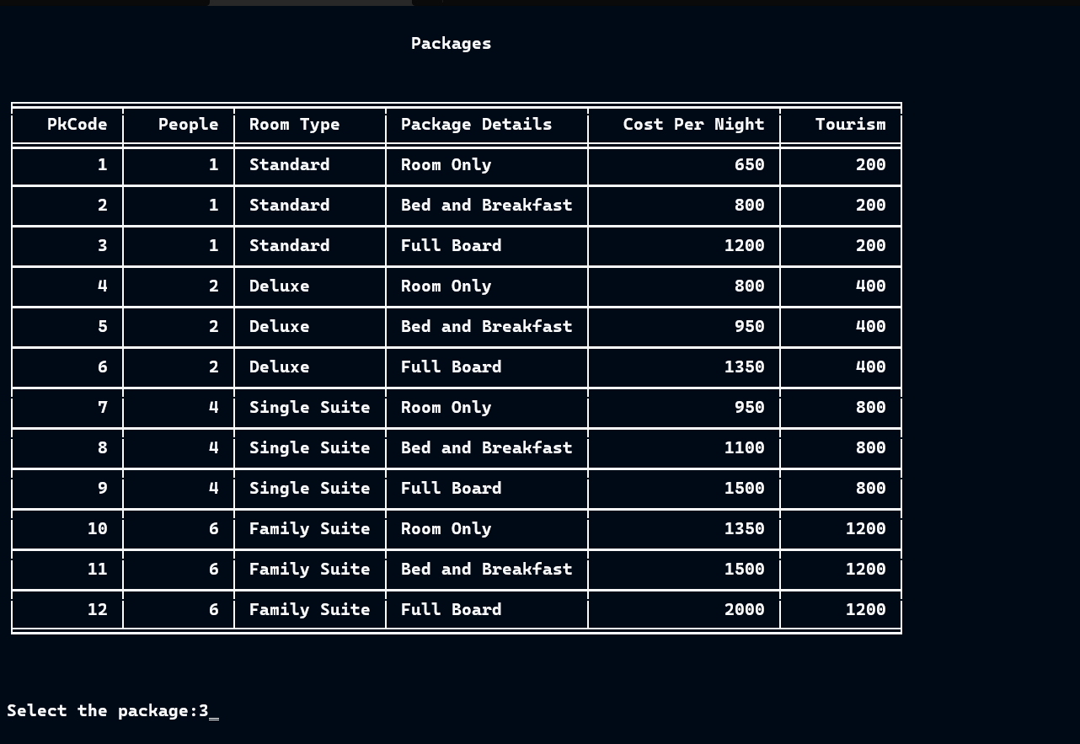
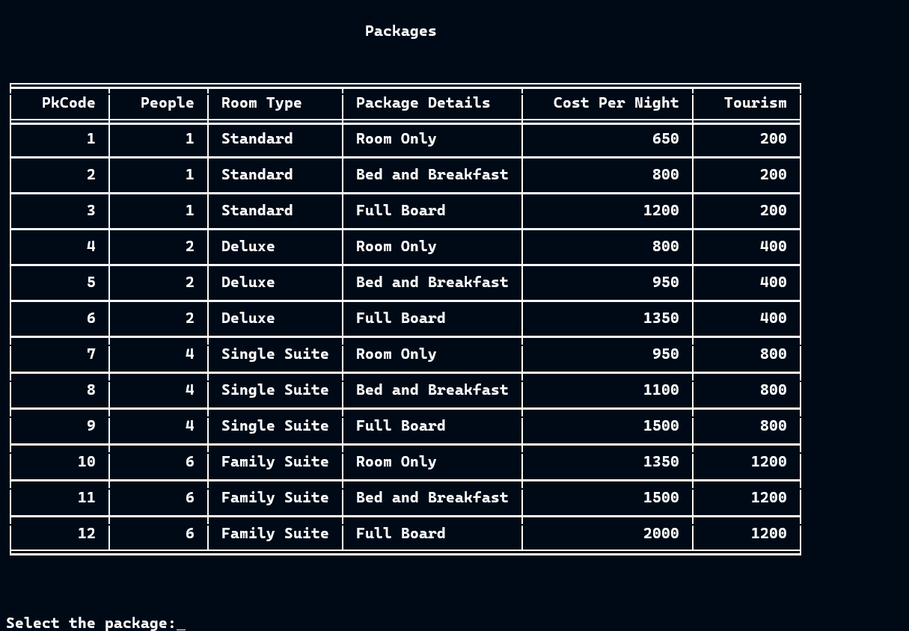
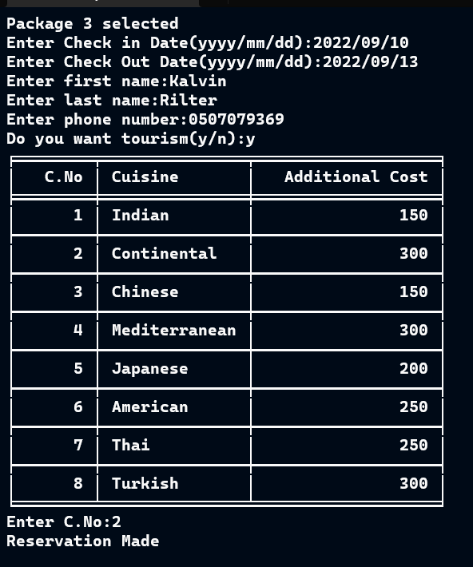
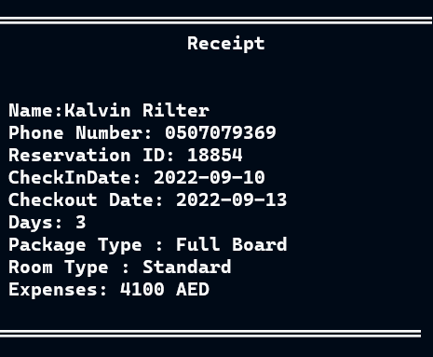
4) Making a reservation

Slide 25
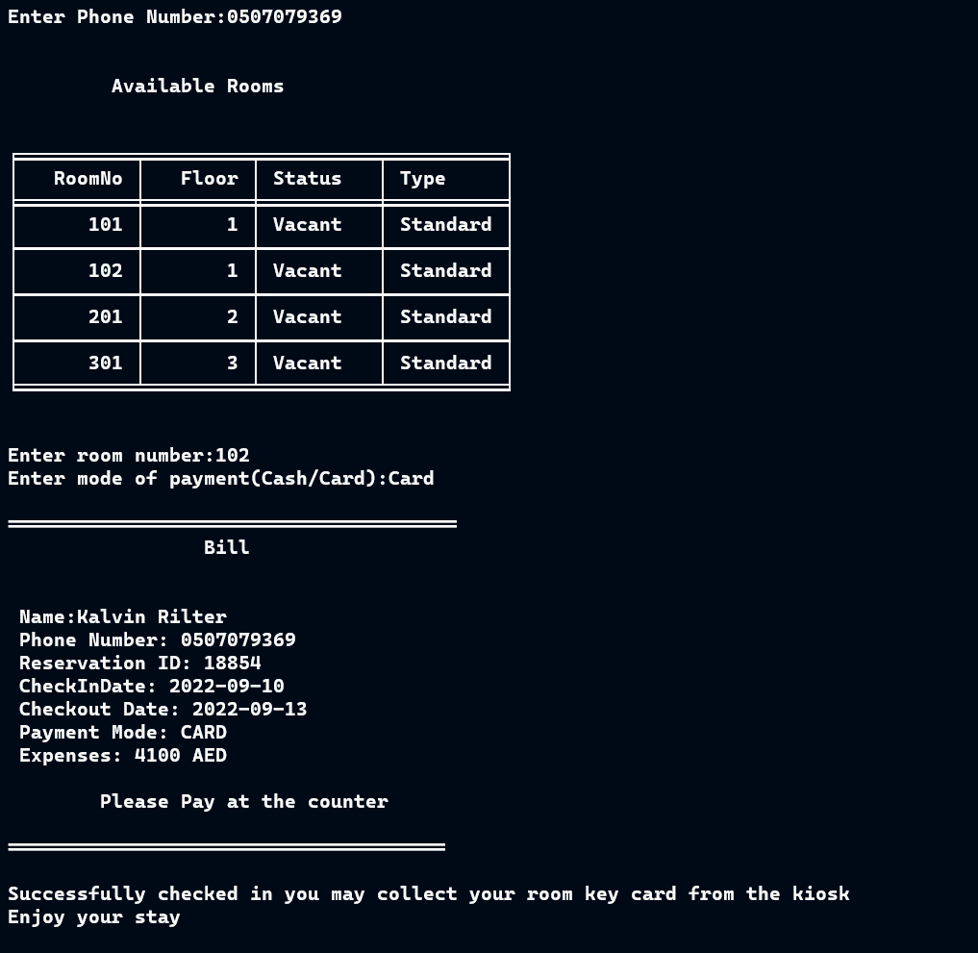
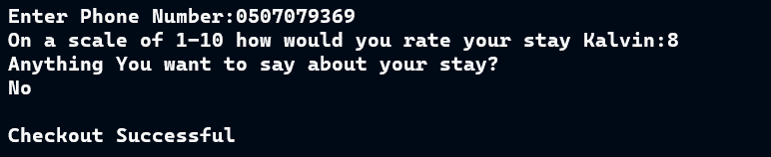
5) Check In
5) Check Out

Slide 26
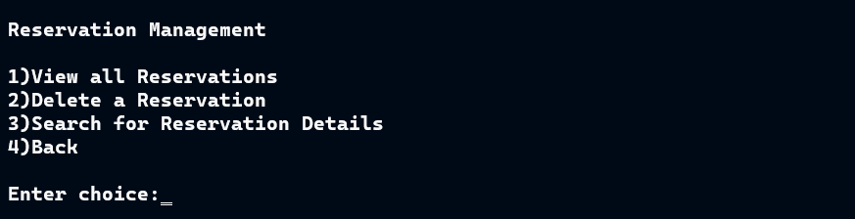
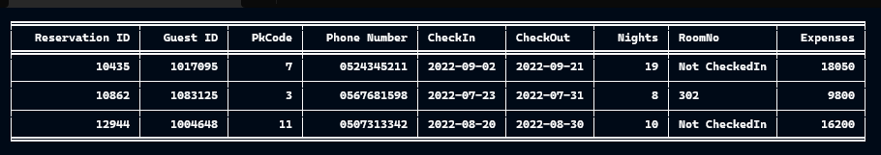
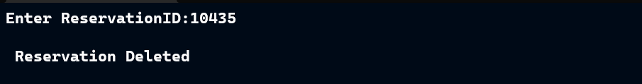
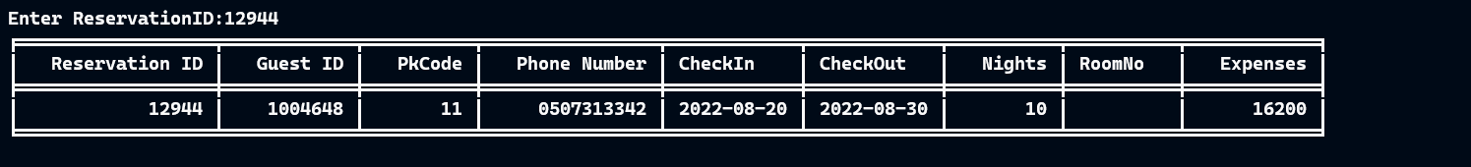
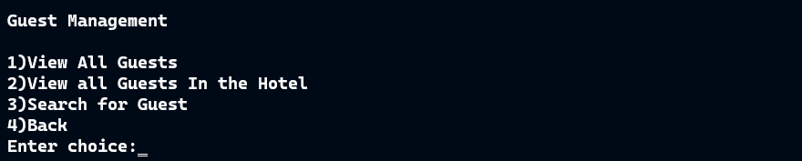
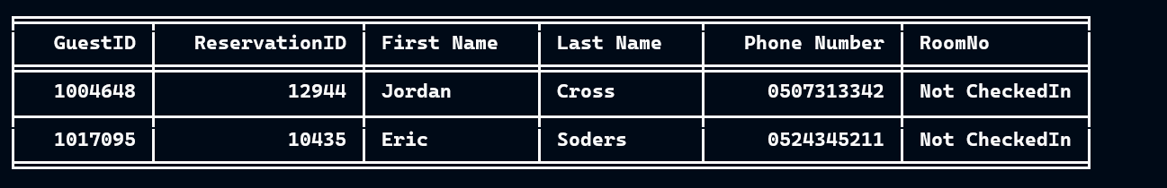
6) Reservation Managment
7) Viewing all Reservations
8) Deleting a Reservation
9) Searching for Reservation Details
10) Guest Managment
11) Viewing all Guests

Slide 27
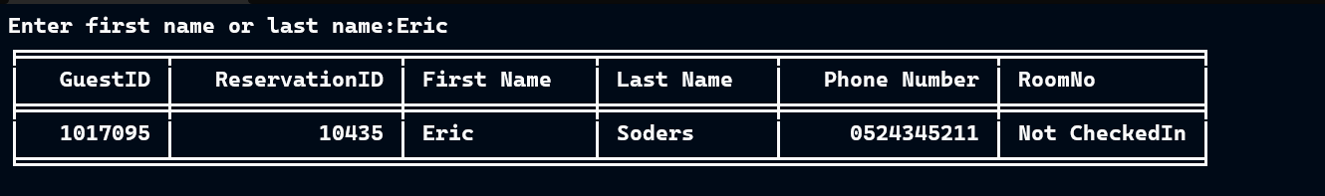
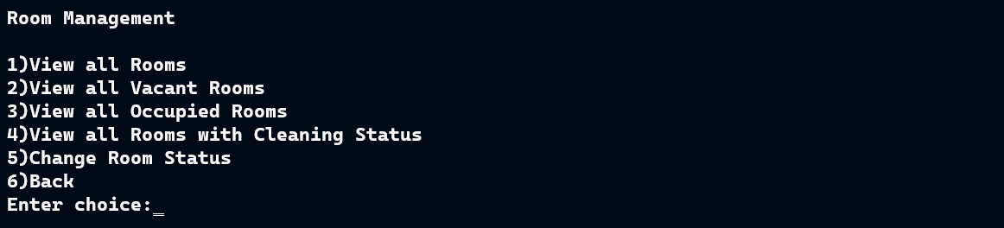
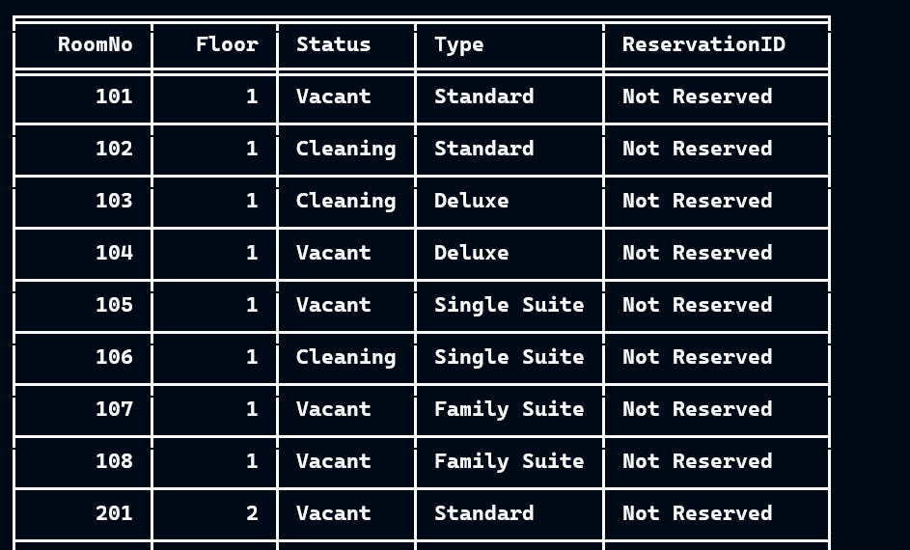
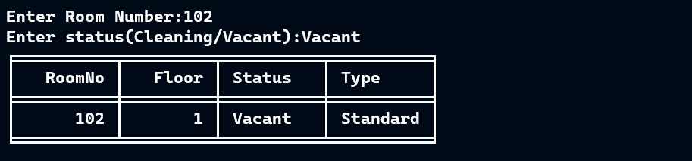
12) Searching for Guest Details
13) Room Management
13) Viewing all Rooms
14) Changing Room Status

Slide 28
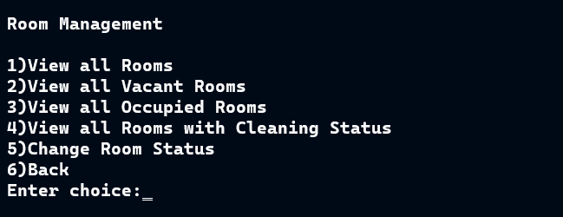
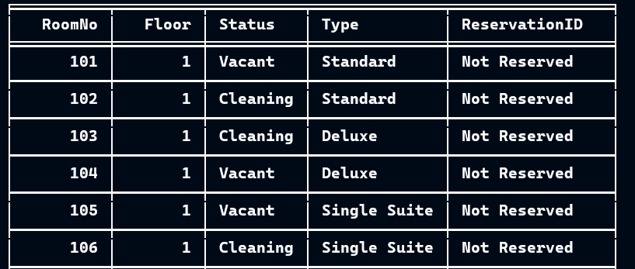
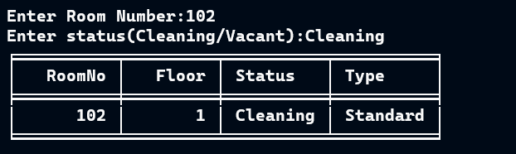
15) Room Management
16) View Rooms
17) Updating Room Status

Slide 29
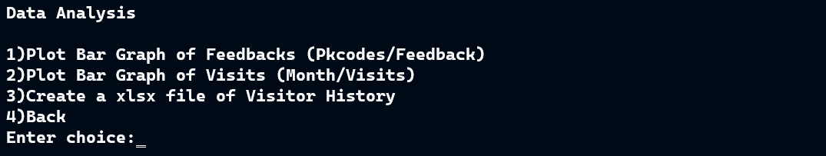
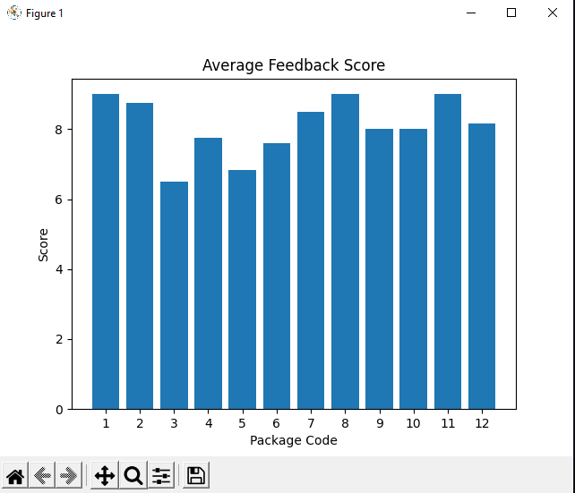
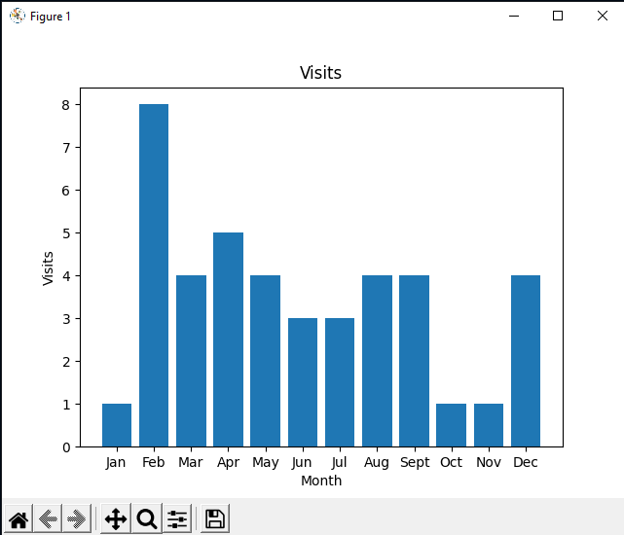
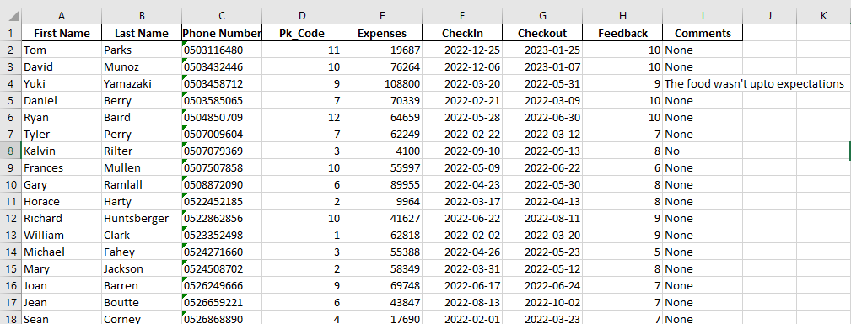
18) Data Analysis
19) Bar Graph of Feedbacks
20) Bar Graph of Visits
21) Generating xlsx file of Visitor History

Slide 30
Conclusion and Futurescope
After successfully completing my project on The Paradise
Hotel, I have verified that I have met all the objectives for the
project. The procedure followed in the project is very simple,
advantageous . The code has been put to several tests and has confirmed that there are no drawbacks or technical errors.I had used all the help that was given to me by my friends and my teacher and I am deeply grateful to them.Further modification can be done in the form of GUI interface which makes it user friendly and it is possible to make an online interface which allows the customers to check in through online
.
THANK YOU!!!

Slide 31
Bibliography
https://www.spyder-ide.org/
https://www.python.org/
https://en.wikipedia.org/wiki/Matplotlib
https://en.wikipedia.org/wiki/Pandas_(software)
https://analyticsindiamag.com/beginners-guide-to-tabulate-python-tool-for-creating-nicely-formatted-tables/

